Slide 1
Embedded Real Time Operating Systems
EMBEDDED HARDWARE DESIGN AND DEVELOPMENT
B. Mallikarjuna Naik
Asst.Prof CRIT

Slide 2
Analog electronic components

Slide 3
Analog electronic components
Commonly used analog electronic components used in embedded hardware design.
Resistors
Capacitors
Diodes
Inductors
Op-Amps
Transistors

Slide 4
Digital electronic components
Deals with digital or discrete signals.
Microprocessors
Microcontrollers
SoC( System on Chip)
Glue Logic
Notes:
Glue logic is the custom digital electronic circuitry required to achieve compatible interface between two different Ics.
Address decoders, latches, encoders/decoders are the examples for glue logic.

Slide 5
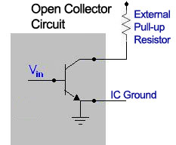
DIGITAL ELECTRONIC COMPONENTS
Open collector and Tri-State output:
Interface between IC output to other systems.
Output line from IC circuit is connected to the base of an NPN transistor.
Collector of a transistor is left unconnected (floating) and emitter is internally grounded.

Slide 6
For output pin to function properly, the output pin should be pulled, to the desired voltage for the output device, through a pull-up resistor.
When the base drive to the transistor is ON and the collector is in open state, the output pin floats (High Impedance state).
If a pull-up resistor is connected to the output pin, when the transistor is in ON, the output pin becomes at logic ZERO(0v).
If a pull-up resistor is connected to the output pin, when the transistor is in OFF, the output pin becomes at logic HIGH(Vcc).

Slide 7
ADVANTAGES OF OPEN COLLECTOR:
Facilitates the interfacing of devices, operating at different voltages from the IC, with the IC.
Supports multi-drop connection, i.e. connecting more than one open collector output to a single line.
Easy to build ‘Wired AND’ and ‘Wired OR’ configurations.

Slide 8
The output of a standard logic has two states, namely ‘Logic 0(LOW)’ and ‘Logic 1(HIGH)’, and the output will be at any one of these states.
Whereas tri-state devices have three states namely, ‘Logic 0(LOW)’, ‘Logic 1(HIGH)’ and ‘High Impedance (FLOAT)’.
A tri-state logic device contains a device activation line called ‘Device Enable’.

Slide 9
When the ‘Device Enable’ is activated, the device acts like a normal logic device and the output will be in any one of the state (either 0 or 1).
When the ‘Device Enable’ is de-activated, the output of the logic device enters in a high impedance state and the device is said to be in floating state.

Slide 10
LOGIC GATES:
Building blocks of digital circuits.
Logic gates control the flow of digital information by performing a logical operation of the input signals.
AND, OR, NOT, XOR, NAND, NOR, XNOR.
BUFFER:
It increases the driving capability of a logic circuit.
A tri-state buffer is a buffer with Output Enable control.
When the Output Enable is active the tri-state buffer functions as buffer.
If Output Enable is not active, the output buffer remains in high impedance state(Tri-stated).

Slide 11
LATCH:
Used for storing one bit of information.
Flip-Flop:
It contains an input data line, clock or gating control line for triggering the latching operation and an output line.
The gating signal can be either a positive edge(raising edge), a negative edge(falling edge) or level triggered one.

Slide 12
Multiplexers
A multiplexer has
N control inputs
2^{N} data inputs
1 output
A multiplexer routes (or connects) the selected data input to the output.
The value of the control inputs determines the data input that is selected

Slide 13
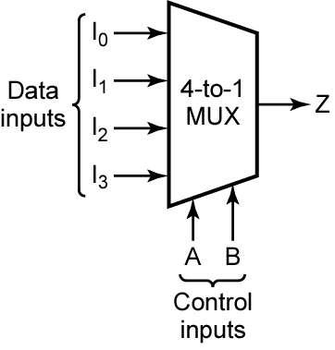
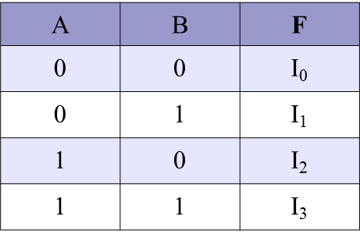
Multiplexers
Z
MSB
LSB
Z = A′.B'.I₀ + A'.B.I₁ + A.B'.I₂ + A.B.I₃

Slide 14
De-multiplexers
A demultiplexer has
N control inputs
1 data input
2^{N} outputs
A demultiplexer routes (or connects) the data input to the selected output.
The value of the control inputs determines the output that is selected.
A demultiplexer performs the opposite function of a multiplexer.

Slide 15
De-multiplexers
Out₀
W
W = A'.B'.I
Out₁
X
I
In
X = A.B'.I
Out₂
Y
Y = A'.B.I
Out₃
Z
S₁
S₀
Z = A.B.I
A
B
A | B | W | X | Y | Z
0 | 0 | I | 0 | 0 | 0
0 | 1 | 0 | I | 0 | 0
1 | 0 | 0 | 0 | I | 0
1 | 1 | 0 | 0 | 0 | I

Slide 16
Decoders
DECODERS:
A decoder has
N inputs
2^{N} outputs
A decoder selects one of 2^{N} outputs by decoding the binary value on the N inputs.
The decoder generates all of the minterms of the N input variables.
Exactly one output will be active for each combination of the inputs.

Slide 17
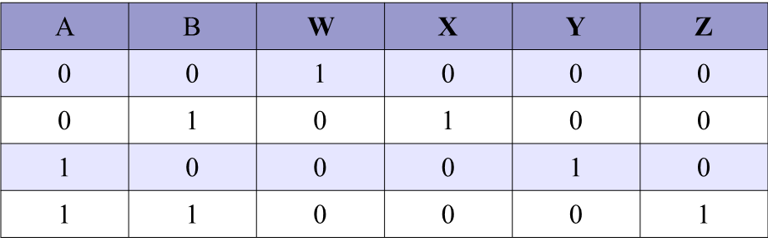
Decoder
W = A'.B'
Out₀
W
B
I₀
Out₁
X
X = A.B'
A
I₁
Out₂
Y
Y = A'.B
Out₃
Z
Z = A.B

Slide 18
Encoder
An encoder has
2^{N} inputs
N outputs
An encoder outputs the binary value of the selected (or active) input.
An encoder performs the inverse operation of a decoder.
Issues
What if more than one input is active?
What if no inputs are active?

Slide 19
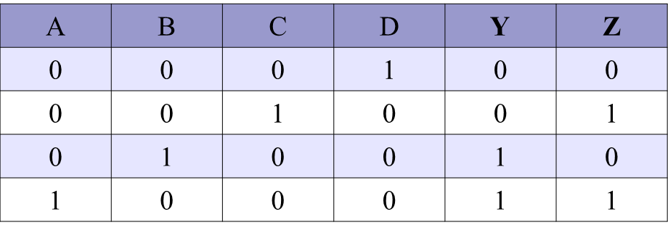
Encoders
D
I₀
C
I₁
Out₀
Z
Out₁
Y
B
I₂
A
I₃

Slide 20
Priority encoders
If more than one input is active, the higher-order input has priority over the lower-order input.
The higher value is encoded on the output
A valid indicator, d, is included to indicate whether or not the output is valid.
Output is invalid when no inputs are active
d = 0
Output is valid when at least one input is active
d = 1

Slide 21
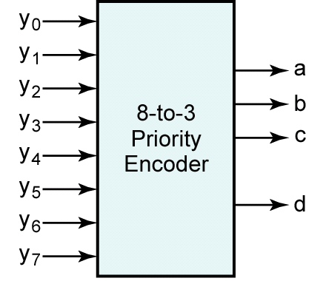
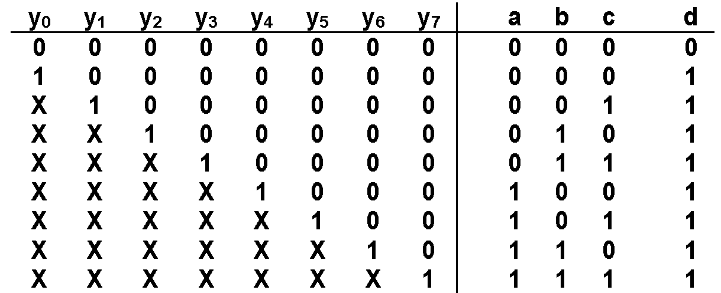
Priority encoders
msb
Valid bit

Slide 22
VLSI AND INTEGRATED CIRCUIT DESIGN
Vacuum tube technology
Transistors
IC

Slide 23
VLSI design
What is VLSI?
“Very Large Scale Integration”
Defines integration level
1980s hold-over from outdated taxonomy for integration levels
Obviously influenced from frequency bands, i.e. HF, VHF, UHF
Sources disagree on what is measured (gates or transistors?)
SSI – Small-Scale Integration (0-10²)
MSI – Medium-Scale Integration (10²-10³)
LSI – Large-Scale Integration (10³-10⁵)
VLSI – Very Large-Scale Integration (10⁵-10⁷)
ULSI – Ultra Large-Scale Integration (>=10⁷)

Slide 24
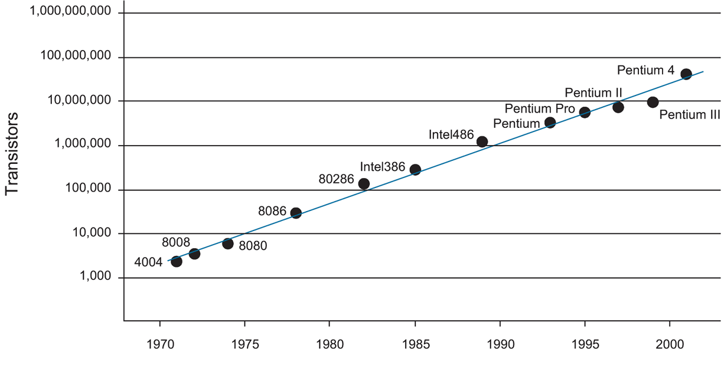
Integration Level Trends
Obligatory historical Moore’s law plot

Slide 25
Chips
Integrated circuits consist of:
A small square or rectangular “die”, < 1mm thick
Small die: 1.5 mm x 1.5 mm => 2.25 mm²
Large die: 15 mm x 15 mm => 225 mm²
Larger die sizes mean:
More logic, memory
Less Production
Dies are made from silicon (substrate)
Substrate provides mechanical support and electrical common point

Slide 26

VLSI Design
Draw polygons that represent layers deposited-on or infused-into the substrate
More of an art than science
One 2-input NAND gate with 4 transistors
Typical microprocessor contains 50 – 200 million transistors (10-50 million gates)
Scale: approximately 10 um x 10 um

Slide 27
VLSI design
Manual layout design is obviously not practical
Design complexity:
Manually drawing layout for a billion transistors would take too long
Even if we could…
How to verify (test) designs for functionality, speed, power, etc.?
Complexity scales faster than actual design
How to reuse designs?
How to create human-readable designs?
How to speed-up design process?
These problems form a great deal of work
Electronic Design Automation (EDA)
a.k.a. CAD
Advancing EDA technology, fabrication technology, designs and microarchitectures, and IP form bulk of work (and money) in the industry

Slide 28
EDA TOOLS

Slide 29
Why EDA?
Imagine a Intel based micro processor having 1.5 million transistors. Would it be feasible to design such a complex system with help of truth table and K-maps?
Obviously Impossible.

Slide 30
Continued
Today’s semiconductors and electronic systems are complex that designing them would be impossible without electronic design automation (EDA). This primer provides a comprehensive over view of the electronic design process, then describes how design teams use Cadence tools to create the best possible design in the least amount of the time.

Slide 31
Digital Design Flow
Design Analysis
Design Specification
Verilog/
VHDL
Library
Design Implementation using HDL
Std., Cell.
Library
Synthesis
Simulation
Look up
Table for
timing
Timing Analysis
Tech file
For layout
values
Place & Route
Tech file
For RC
Parasite
extraction
Extraction
Verification

Slide 32
Design Analysis
Design Analysis
Design Specification
Design Implementation using HDL
This is a very crucial step in digital
design where the design functionality
is stated.
Like if we are making a processor,
what type of functionality is expected??
Synthesis
Simulation
Timing Analysis
Place & Route
Extraction
Verification

Slide 33
Design Specification
This step involved stating in definite
terms the performance of the chip.
Like if we are making a processor,
data size, processor speed, special
functions, power etc. is clearly stated
at this point. Also somewhat it is decided,
the way to implement the design.
So, it deals with architectural part of the
design at highest level possible.
Based on these foundation , the whole
design is built
Design Analysis
Design Specification
Design Implementation using HDL
Synthesis
Simulation
Timing Analysis
Place & Route
Extraction
Verification

Slide 34
HDL
Design Analysis
Hardware Description Language is used
to run the simulations.
It is very expensive to build the entire
chip and then verify the performance of
the architecture. Imagine if after designing
a chip for a whole year, the chip fabricated,
does not come even closer to the stated
specifications.
Design Specification
Design Implementation using HDL
Synthesis
Simulation
Timing Analysis
Place & Route
Extraction
Verification

Slide 35
HDL (contd.)
Design Analysis
Hardware description languages provides
a way to implement a design without going
into much architecture, simulate and verify
the design output and functionality.
Design Specification
Design Implementation using HDL
Synthesis
Simulation
Timing Analysis
For eg. rather than building a mux design
in hardware, we can write verilog code
and verify the output at higher level
of abstraction.
Examples of HDL: VHDL, Verilog HDL
Place & Route
Extraction
Verification

Slide 36
HDL (Contd.)
Design Analysis
At this time we can see the design
in the form of Source Codes.
It seems more of the software
visualization of the circuit.
The simulated code is taken to
Synthesis to generate the Logic
Circuit.
Design Specification
Design Implementation using HDL
Synthesis
Simulation
Timing Analysis
Place & Route
Extraction
Verification

Slide 37
Synthesis
Design Analysis
Imagine the use of K-Maps and Truth
Tables to make and implement a digital
design.
If you notice, most of the digital designs
are build up of some basic elements or
components like gates, registers, counters,
adders, subtractors, comparators, RAM,
ROM etc.
It forms the fundamentals of Logic
Synthesis using EDA tools.
Design Specification
Design Implementation using HDL
Synthesis
Simulation
Timing Analysis
Place & Route
Extraction
Verification

Slide 38
Synthesis (Contd.)
Design Analysis
Design Specification
Standard Cell Library is the collection
of such building blocks which comprises
most of the digital designs.
These cell libraries are fabrication
technology specific.
Design Implementation using HDL
Synthesis
Simulation
Timing Analysis
Place & Route
Extraction
Verification

Slide 39
Synthesis ( Contd.)
Design Analysis
After the RTL simulation, the HDL,
code is taken as input by Synthesis
Tool and converted to Gate level.
At this stage that the digital design
becomes dependent on the
fabrication process.
At the end of this stage, we have
the logic circuit I.e. in terms of
gates and memories.
Design Specification
Design Implementation using HDL
Synthesis
Simulation
Timing Analysis
Place & Route
Extraction
Verification

Slide 40
Synthesis ( Contd.)
Design Analysis
What synthesis does is , when it
encounters a specific construct
in HDL it replaces it with the
corresponding Standard Cell
Component from the library to
build the entire design.
Like if we use a for loop , it gets
converted to counter and a
combinational circuit.
Design Specification
Design Implementation using HDL
Synthesis
Simulation
Timing Analysis
Place & Route
Extraction
Verification

Slide 41
Synthesis ( Contd.)
Design Analysis
The output of synthesis is a gate
level netlist.
Netlist is an ASCII file which
enlists and indicates the devices
and the interconnections between
them.
Design Specification
Design Implementation using HDL
Synthesis
Simulation
Timing Analysis
Place & Route
Extraction
Verification

Slide 42
Simulation
Design Analysis
After the netlist is generated as part
of synthesis, this netlist is simulated
to verify the functionality of this
gate level implementation of design.
Till this level we just dealt with
functionality part. Now each step
onward deals with performance
part too.
Design Specification
Design Implementation using HDL
Synthesis
Simulation
Timing Analysis
Place & Route
Extraction
Verification

Slide 43
Timing Analysis
Design Analysis
RTL and Gate Level simulation
doesn’t take into account the physical
time delay in signal propagation from
one device to another and through
the device.
This time delay is dependent on the
fabrication process adopted.
Design Specification
Design Implementation using HDL
Synthesis
Simulation
Timing Analysis
Place & Route
Extraction
Verification

Slide 44
Timing Analysis (Contd.)
Design Analysis
Each component in standard cell
library is associated with some
specific delay.
Delay Lookup Tables list the
delays associated with the
components.
Delays are in the form of
rise time, fall time and turn off
time delays.
Design Specification
Design Implementation using HDL
Synthesis
Simulation
Timing Analysis
Place & Route
Extraction
Verification

Slide 45
Timing Analysis (Contd.)
Design Analysis
Most of the digital designs employ
concept of timing by using clocks.
This makes the circuits synchronous.
Consider an AND gate with two inputs,
x and y. If at time t = 1 ns, x is available,
and y comes 1 ns later, what would be
the output. This mismatch in timing
leads to erroneous performance of design.
Design Specification
Design Implementation using HDL
Synthesis
Simulation
Timing Analysis
Place & Route
Extraction
Verification

Slide 46
Timing Analysis (Contd.)
Design Analysis
Design Specification
In timing analysis, using Delay
Lookup Tables, all the inputs
and outputs of components are
verified with timing introduced.
Design Implementation using HDL
Synthesis
Simulation
Timing Analysis
Place & Route
Extraction
Verification

Slide 47
Place & Route
Design Analysis
This is the actual stage where
the design implemented at
semiconductor layout level.
This is the stage which really
requires more knowledge of
semiconductor physics than
digital design.
Design Specification
Design Implementation using HDL
Synthesis
Simulation
Timing Analysis
Place & Route
Extraction
Verification

Slide 48
Place & Route (Contd.)
Semiconductor layout has to follow
certain design rules to lay devices
at semiconductor level.
These design rules are fabrication
process dependent.
The layout uses layers as p/n diffusion,
nwell, pwell, metals, via, etc.
Rules involving min. spacing, and
electrical relation between two layers
are known as DESIGN RULES.
Design Analysis
Design Specification
Design Implementation using HDL
Synthesis
Simulation
Timing Analysis
Place & Route
Extraction
Verification

Slide 49
Place & Route (Contd.)
Design Analysis
Design Specification
Placement and Routing involves
laying of the devices, placing them
and making interconnection between
them, following the Design Rules.
The result is the design implemented
in the form of semiconductor layers.
Design Implementation using HDL
Synthesis
Simulation
Timing Analysis
Place & Route
Extraction
Verification

Slide 50
Extraction
Design Analysis
Once the layout is made, there always
is parasitic capacitances and resistances
associated with the design.
This is because of the compact layouts
to make the chips smaller. More you make
compact layout more will it introduce
these parasitic components. These
interferes in the functioning and
performance of the circuit in terms of
timing, speed and power consumption.
Design Specification
Design Implementation using HDL
Synthesis
Simulation
Timing Analysis
Place & Route
Extraction
Verification

Slide 51
Extraction (Contd.)
Design Analysis
Due to these factors it becomes very
much important to extract these devices
from layout and check the design for
performance and functionality.
Extraction would extract from the layout,
the devices formed because of junctions
of different semiconductor and metal
layers and the interconnections.
Design Specification
Design Implementation using HDL
Synthesis
Simulation
Timing Analysis
Place & Route
Extraction
Verification

Slide 52
Verification
Design Analysis
Design Specification
Verification would either be the
tape out stage of the chip or the stage
where design is again taken back
through the same flow for
optimization or modification.
It verifies the extracted view of the
chip for performance and functionality.
Design Implementation using HDL
Synthesis
Simulation
Timing Analysis
Place & Route
Extraction
Verification

Slide 53
VHDL FOR VLSI DESIGN
VHDL : technology independent description which enables creation of designs targeted for a chosen technology(CPLD, FPGA)
Describes functionality and behaviour of the system [Behavioural representaion], or describes the actual gate and register levels of the system[RTL].

Slide 54
VHDL
Comment : -- two adjacent hyphens
Identifier: reserved words chosen for entity and signal description. Non-Case SensitiVe
Character: ASCII character in single quote ‘A’, ‘a’ etc.
String: characters grouped in double quotes “VHDL”.
Bit strings: Array of bits with Base. B”100”, O”127”, X”1F9”.
Numerals: universal_integer doesnot include points and universal_real includes a point, 1000 as 1_000 , 1E3 as exponent, 2#011# for binary 3.

Slide 55
VHDL
If statement: if condition then
- - corresponding actions
else
- - corresponding actions
end if;
Case statement: case expression
when case 0
-- statements or case;
when others
-- statements or default case;
end case;

Slide 56
VHDL
Loop statement: loop
- - body of loop;
end loop;
While loop: while expression loop
- - body of loop;
end loop;
For loop: for item in start item to end item loop
- - body of loop
end loop;

Slide 57
VHDL
Important syntax rules:
Reserved words are written in bold letters
All statements end with a semicolon(;)
| is used for separating mutually exclusive alternatives.
( ) is used for clarifying the order in which a rule is evaluated.
{ } used for representing optional things that may occur once or many times or never
[ ] used for representing optional things that may occur once or never.

Slide 58
VHDL
Library ieee;
Use ieee.std_logic_logic_1164.all
Entity DFF is
Port (D, clk:in bit, q: out bit);
End DFF;
Architecture DFF_arch of DFF is
Begin
Process(D,clk)
Begin
if clk=‘1’ and clk’event then
Q<=D;
End if;
End process;
End DFF_arch;

Slide 59
VHDL
VHDL or Verilog Description
Functional simulation
Area and Timing constraints
Technology Library
Synthesis
Placement and Routing
Timing Simulation

Slide 60
EDA TOOLS
Early embedded products through hand made PCB with the help of oil paper, pencil, pen ruler and copper plates.
Etching done for weeks and months too
Accuracy ???
Software versions came into existence called EDA tools
EDA tool a set of CAD/CAM

Slide 61
Major Companies in EDA Tools
Cadence Design Systems
Synopsys
Avanti
Tanner

Slide 62
Embedded firmware design approaches
Firmware design approaches for embedded product is purely dependent on the complexity of the functions to be performed, the speed of operation required, etc.
Two approaches
1. Conventional procedural based firmware design
2. Embedded operating system based design
Conventional approach is also called as ‘Super Loop Model’.

Slide 63
Super Loop Based Approach
Adopted for applications that are not time critical.
Similar to conventional procedural programming where the code is executed task by task.
The firmware execution flow for multiple task based system will be
1. Configure the common parameters and perform initialization for various hardware components, memory, registers, etc.
2. Start the first task and execute it
3. Execute second task
4. Execute next task

Slide 64
5.
6.
7. Execute the last defined task
8. Jump back to the first and follow the same flow
Tasks that to be executed are fixed.
The operation is an infinite loop based approach which is also referred as ‘Super Loop Based Approach’.
Since the tasks are running inside an infinite loop, the only way to come out of the loop is either a hardware reset or an interrupt assertion.

Slide 65
Super Loop Based Approach
Doesn’t require any operating system, since there is no need for scheduling which task is to be executed and assigning priority to each task.
Major drawback of this approach is that any failure in any part of a single task will affect the total system.
Use of hardware and software Watch Dog Timers helps coming out of the loop.
Another drawback of super loop design is lack of real timeliness.

Slide 66
Embedded operating system based approach
Contains operating systems, which can be either a general purpose operating system(GPOS) or Real Time Operating System(RTOS) to host the user written application firmware.
OS based applications also require ‘Driver Software’ for different hardware present on the board to communicate with them.
RTOS respond in a timely and predictable manner to events.
Real time operating system contains a Real Time kernel responsible for performing pre-emptive multi-tasking, schedule for scheduling tasks, multiple threads, etc.

Slide 67
Embedded firmware development languages
We can use either a target processor/controller specific language(generally known as assembly language or low level language)
or
a target processor/controller independent language( like C, C++, JAVA, etc. commonly known as High Level language) or a combination of both.

Slide 68
Assembly language based development
‘Assembly language’ is the Human readable notation of ‘Machine language’, whereas ‘machine language’ is a processor understandable language.
Machine language is made readable by using specific symbols called ‘mnemonics’.
Most adopted in the beginning of software revolution.
The general format of an assembly language instruction is an Opcode followed by Operands.
Opcode tells the processor what to do and the operands provide data and information required to perform the action specified by the opcode.

Slide 69
Assembly language based development
MOV A, #30 is an example for Opcode and Operands. The same will look like in machine language as 01110100 00011110.
Where the first 8 bits represents the Opcode MOV A and the second byte represents the operand value.
INC A is an implicit instruction and LJMP 16bit address is an dual operand instruction.
Assembly language instructions are written one per line.
LABEL OPCODE OPERAND COMMENTS

Slide 70
Simple programs
1. DELAY: MOV R0, #255 ; Load register R0 with 255
DJNZ R1, DELAY; Decrement R1 and loop till R1=0
RET ; Return to calling program
2. ORG 0100H ; pseudo-ops
MOV R0, #255 ; Load register R0 with 255
DJNZ R1, 0100H; Decrement R1 and loop till R1=0
RET ; return to calling program

Slide 71
Assembly language based development
Assembly language program written in assembly code is saved as .asm file or .src file.
Similar to C and other high level programming, we can save multiple source files called modules in ALP. This approach is called Modular Programming.
The entire code is divided into sub modules and each module is made re-usable.
Modular programs are easy to code, debug and alter.

Slide 72
Assembly to machine language conversion process
Library Files
Source file 1
(Module-1)
Module assembler
Object File 1
Source file 2
(Module-2)
Module assembler
Object File 2
Object to Hex file Converter
Absolute Object file
Linker/
Locater
Machine Code (Hex file)

Slide 73
Advantages of assembly language based development
The most common technique adopted from the beginning of embedded technology.
Processor architecture, memory organisation, register sets and mnemonics is very essential one.
Major advantages of ALP based development are
Efficient code memory and data memory usage
High performance
Low level hardware access
Code reverse engineering

Slide 74
Drawbacks of Assembly based development
High Development Time
Much harder than high level languages. Learning the inner details of the processor and its assembly instruction set takes long time.
Developer Dependency
No common written rule for developing assembly language based applications. Programming approach differs from one developer to another.
Non-Portable
Target applications written in assembly instructions are valid for that particular family of processors and cannot be re-used for another processor.

Slide 75
High Level Language Based Development
Need for High Level Language?
Any high level language with a supported cross compiler for the target processor can be used for embedded firmware development.
The most commonly used high level language for embedded firmware application development is ‘C’.

Slide 76
High Level Language to machine language conversion Process
Library Files
Source file 1
(Module-1)
Module Cross-compiler
Object File 1
Source file 2
(Module-2)
Module
Cross-compiler
Object File 2
Object to Hex file Converter
Absolute Object file
Linker/
Locater
Machine Code (Hex file)

Slide 77
Advantages of High Level Language Based Development
Reduced development Time
Developer requires less or little knowledge on the internal hardware details.
Memory organisation and register details of the target processor in use and syntax of the high level language are the only pre-requisites for high level programming. Rest will be taken care by the cross-compilers.
Developer Independency
Portability

Slide 78
Limitations
Cross- compilers
Investment

Slide 79
Mixing Assembly and High Level Language
Some embedded firmware situations may demand the mixing of high level language with assembly and vice versa. The ways of mixing are
Mixing Assembly language with High Level Language
Mixing high level language with Assembly and
In-line assembly programming.

Slide 80
Mixing assembly with high level language
Assembly routines are mixed with ‘C’ in situations where the entire program is written in ‘C’ and the cross compiler in use do not have a built in support for implementing certain features like ISR functions.
Mixing ‘C’ and Assembly is little complicated in the sense- the programmer must be aware of how parameters are passed from the ‘C’ routine to assembly and values are returned from assembly routine to ‘C’ and how “Assembly routine’ is invoked from the ‘C’ code.

Slide 81
Keil C51 cross compiler for 8051
How mixing of assembly code with ‘C’ done
Write a simple function in C that passes parameters and returns values the way you want your assembly routine to.
Use the SRC directive so that the C compiler generates an .SRC file instead of an .OBJ file.
Compile the C file. Since the SRC directive was specified, the .SRC file is generated. The .SRC file contains the assembly code generated for the C code you wrote.
Rename the .SRC file to .A51 file.
Edit the .A51 file and insert the assembly code you want to execute in the body of the assembly functions shell included in the .A51 file.

Slide 82
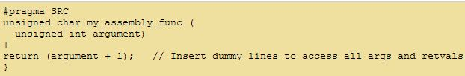
Example
When compiled generates the following assembly SRC file

Slide 83
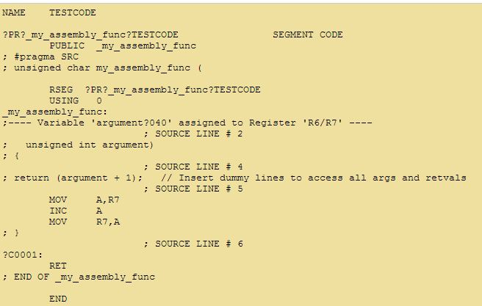

Slide 84
Mixing High level Language with Assembly
Mixing in this format is useful in the following scenarios:
The source code is already available in assembly language and a routine written in a high level language like ‘C’ needs to be included to the existing code.
The entire source code is planned in assembly code for various reasons like optimised code, optimal performance, efficient code memory utilisation and proven expertise in handling the assembly, etc.
To include built in library functions written in ‘C’ language provided by cross compiler.

Slide 85
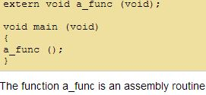
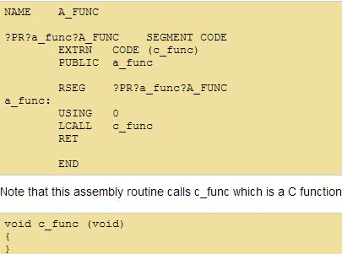
Example

Slide 86
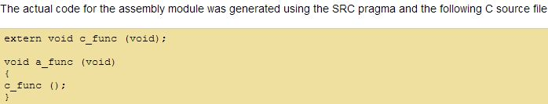
Example contd..

Slide 87
Inline Assembly
Another technique for inserting target processor/controller specific assembly instructions at any location of a source code written in high level language ‘C’.
This avoids the delay in calling an assembly routine from a ‘C’ code.
Uses special keywords #pragma asm and #pragma endasm to indicate start and end of assembly instructions.

Slide 88
Example
extern void test ( );
void main (void) {
test ( );
#pragma asm
JMP $ ; endless loop
#pragma endasm
}

